Slide 1
DASS Usability prototype

Slide 2

Patient questionnaire - please answer the following questions:
1. Age: ____
2. Sex: ☐ Male ☐ Female ☐ Other
3. Condition: IBD ☐ Other: ________
4. In the past 3 months my BD has been:
☐ Constantly active, giving me symptoms every day
☐ Often active, giving me symptoms most days
☐ Sometimes active, giving me symptoms on some days (for instance 1 – 2 days / week)
☐ Occasionally active, giving me symptoms 1 – 2 days / month
☐ Rarely active, giving me symptoms on a few days in the past 6 months
☐ I was well in the past 3 months, what I consider a remission
or absence of symptoms.
Next

Slide 3
Patient questionnaire - please answer the following questions:
 | Very poor | Poor | Neither poor nor good | Good | Very good
5. How would you rate your quality of life? | ☐ | ☐ | ☐ | ☐ | ☐
6. How would you rate your level of social support? | ☐ | ☐ | ☐ | ☐ | ☐
7. Please rate your overall level of self-confidence when it comes to managing your own PHYSICAL health | ☐ | ☐ | ☐ | ☐ | ☐
8. Please rate your overall level of self-confidence when it comes to managing your own MENTAL health | ☐ | ☐ | ☐ | ☐ | ☐
9. How would you rate your quality of sleep? | ☐ | ☐ | ☐ | ☐ | ☐
10. Average number of hours sleep in the last 24 hours? | _________________
Next

Slide 4
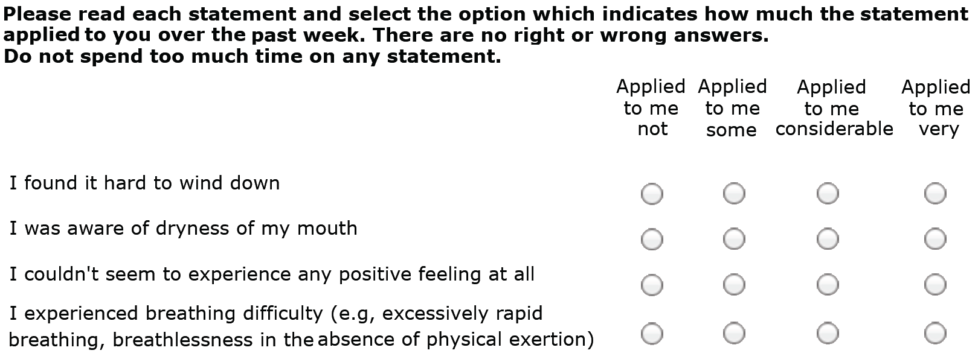
Patient questionnaire - please answer the following questions:
Now have the DASS questions…sample items below normally 21 itms
Next

Slide 5
Patient questionnaire - please answer the following questions:
AFTER DASS QUESTIONS HAVE …
 | YES | NO
Do you consider hurting yourself, others, or feel suicidal? | ☐ | ☐
Do you have an appointment with their mental health expert within the next 14 days or willing to contact their GP if their mental health symptoms worsen? | ☐ | ☐
Are you currently are CURRENTLY seeing a mental health professional? | ☐ | ☐
 | None | Mild | Moderate | Severe | Extreme
Please select the option that best describes your PAIN LEVELS on average over the last 24 hours | ☐ | ☐ | ☐ | ☐ | ☐
Please select the option that best describes your FATIGUE LEVELS on average over the last 24 hours | ☐ | ☐ | ☐ | ☐ | ☐
Next

Slide 6

at this time, the program will score the 21 items into three seperate scores; anxiety, depression, and stress; based on the scores, uss showed on of three responses, then asked to answer follow-up questions
Saving DASS score (will not be displayed)

Slide 7

You are not currently experiencing significant
psychological distress
For further information and strategies to manage psychological distress related to IBD please go to:
Next

Slide 8
You are currently experiencing MILD-TO-MODERATE
psychological distress
We recommend you meet with your mental health professional, or if symptoms worsen, contact your GP
For further information and strategies to manage psychological distress related to IBD please go to:
Next

Slide 9


You are currently experiencing SEVERE
psychological Distress
We recommend you contact your doctor or psychologist within 24 hours and arrange a mental health review. Please also feel free to contact your local hospital IBD/IBS contact.
If you are considering harming yourself or thinking about suicide, please contact, Lifeline.
Next

Slide 10
You are currently experiencing EXTREEMLY SEVERE
psychological Distress
We recommend you contact your doctor or psychologist within 24 hours and arrange a mental health review. If symptoms worsen, contact your doctor/psychologist immediately. Please also feel free to contact your local hospital IBD/IBS contact.
If you are considering harming yourself or thinking about suicide, please contact, Lifeline.
Next

Slide 11
Patient questionnaire – post-feedback questions:
1. How helpful was this advice?
Useless – 1☐ 2☐ 3☐ 4☐ 5☐ 6☑ 7☐ - excellent
2. How likely are you to follow-up if recommendations were
provided?
Not at all– 1☐ 2☐ 3☐ 4☐ 5☑ 6☐ 7☐ - very much so
3. Any other comments: _easy to use____________
Next

Slide 12
Patient questionnaire – post-feedback questions:
We are looking to develop an online support tool that patients can use on a fortnightly basis to report and manage their IBD symptoms, mental health and quality of life. This online service would also allow you to communicate with your health professionals.
4. How helpful would an online out-patient service be to help monitor your IBD activity?
5. How willing would you be to use an online out-patient service to help monitor your mental health?
6. How helpful would an online out-patient service be to help monitor your mental health?
7. How willing would you be to use an online out-patient service to help monitor your mental health?
8. How helpful would an online out-patient service be to help monitor your IBD associated medications?
9. How willing would you be to use an online out-patient service to help monitor your IBD associated medications?
10. How helpful would an online out-patient service be to communicate with your Gastroenterologist/IBD nurse?
each questions scord on the below format
1 | 2 | 3 | 4 | 5 | 6 | 7 | 8 | 9 | 10
Not at all ☐ | ☐ | ☐ | ☐ | ☐ | ☐ | ☐ | ☐ | ☐ | Extremely helpful ☐
Next

Slide 13
Saving feedback (will not be displayed)

Slide 14
Data stored as a unique id, noting day/time, and responses given.
Result ID # 5
Depression: 3
Anxiety: 4
Stress: 2

Slide 15
Thank you for your responses
Please return this tablet to reception
Go back to start screen

